Slide 1
Unit – 3 Part – 3 Multithreading

Slide 2

Multithreading

Slide 3
Multitasking and Multithreading
Multitasking refers to a computer’s ability to perform multiple jobs concurrently
More than one program are running concurrently
A thread is s single sequence of execution within a program
Multithreading refers to multiple threads of control within a single program

Slide 4


Slide 5
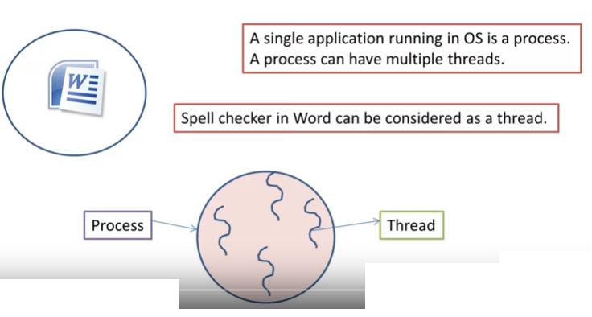
Process v/s Thread

Slide 6
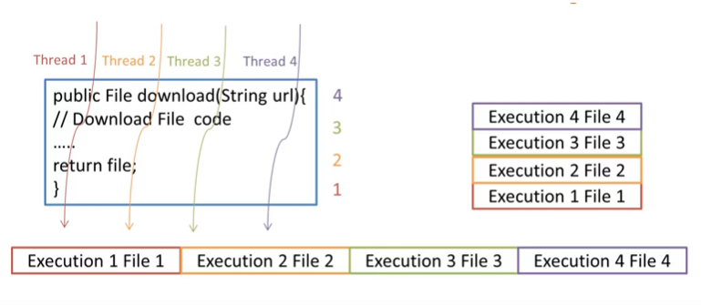
Multithreading

Slide 7
Multithreading
Multithreading in Java is a process of executing multiple threads simultaneously.
Thread is basically a lightweight sub-process, a smallest unit of processing.
Multiprocessing and multithreading, both are used to achieve multitasking.
Java Multithreading is mostly used in games, animation etc.
When main() method is called a thread known as main thread is created to execute the program.
It is the OS which schedules the threads to be processed by the processor. So the scheduling behavior is dependent on the OS.
Nothing can be guaranteed about the threads execution.

Slide 8
What is a thread?
Threads are separate parts of execution which are functionally independent of each other.
Multithreading as the name itself tells that it is regarding, multi tasks(thread).
process:
A process consists of the memory space allocated by the operating system that can contain one or more threads.
A thread cannot exist on its own; it must be a part of a process.
A process remains running until all of the threads are done executing.
Use: Multithreading enables you to write very efficient programs that make maximum use of the CPU, because idle time can be kept to a minimum.

Slide 9
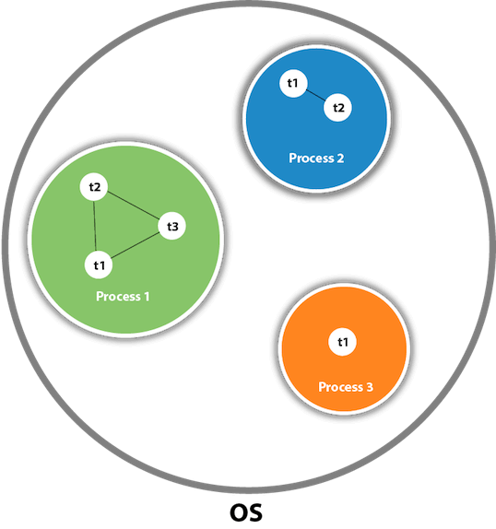
Thread

Slide 10
Life cycle of Thread
There are five stages in thread life cycle:
Newborn State
Runnable State
Running State
Blocked State
Dead State

Slide 11
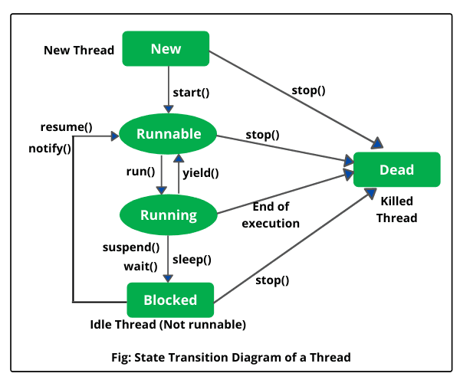
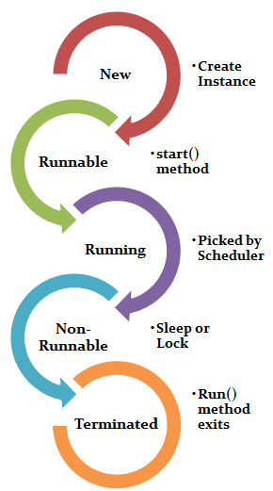
Life cycle of Thread

Slide 12
Life Cycle….
New :
The thread is in new state if you create an instance of Thread class but before the invocation of start() method.
Runnable :
The thread is in runnable state after invocation of start() method, but the thread scheduler has not selected it to be the running thread.
Running:
The thread is in running state if the thread scheduler has selected it.
Non-Runnable (Blocked) :
This is the state when the thread is still alive, but is currently not eligible to run.
Terminated :
A thread is in terminated or dead state when its run() method exits.

Slide 13
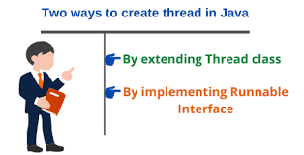
Creating a Thread
Java defines 2 ways to achieve multithreading :
By extending the Thread class itself.
By implementing the Runnable interface

Slide 14
Extending a Thread class :
class Main extends Thread
{
public void run()
{
System.out.println("This code is running in a thread");
}
}
Implementing Runnable interface :
class Main implements Runnable
{
public void run()
{
System.out.println("This code is running in a thread");
}
}

Slide 15
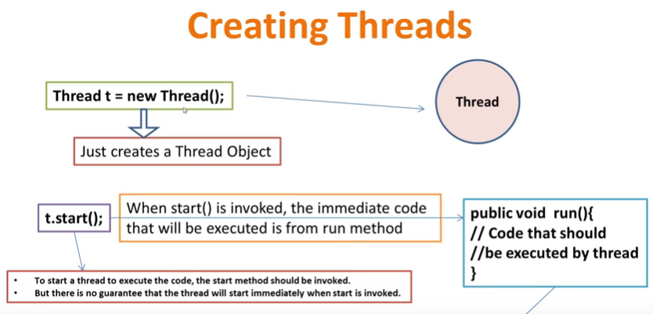

Slide 16
Thread Class
Thread() :
Allocates a new Thread object.
Thread(String name):
Allocates a new Thread object with user define name.
Thread(Runnable target):
Allocates a new Thread object
target - the object whose run method is called.
Thread(Runnable target, String name):
Allocates a new Thread object
target - the object whose run method is called.
name - the name of the new thread.

Slide 17
Methods…
Method Name | Description
setName() | to give a name to thread
getName() | return thread's name
getPriority() | return thread's priority
setPriority() | Set priority of thread
isAlive() | checks if thread is still running or not
join( ) | Wait for a thread to end
run( ) | Entry point for a thread
sleep() | suspend thread for a specified time
start() | start a thread by calling run() method

Slide 18
Methods…
Method Name | Description
resume() | Resumes this Thread’s execution.
suspend() | Suspends this Thread's execution.
void yield() | Causes the currently executing thread object to temporarily pause and allow other threads to execute.

Slide 19
Create Thread by Extending Thread:
The First way to create a thread is to create a new class that extends Thread, and then to create an instance of that class.
The extending class must override the run() method, which is the entry point for the new thread.
It must also call start( ) to begin execution of the new thread.
Example

Slide 20
Create Thread by Implementing Runnable
The easiest way to create a thread is to create a class that implements the Runnable interface.
To implement Runnable, a class needs to only implement a single method called run( ), which is declared like this:
public void run( )
You will define the code that represents the new thread inside run() method.
Example

Slide 21
Cont…
After creating a class that implements Runnable, have to instantiate an object of type Thread from within that class.
Thread defines several constructors. The one that we will use is shown here:
Thread(Runnable threadOb, String threadName);
Here, threadOb is an instance of a class that implements the Runnable interface and the name of the new thread is specified by threadName.
After the new thread is created, it will not start running until you call its start( ) method, which is declared within Thread.

Slide 22
Using Sleep()
Syntax:
static void sleep(long miliseconds)
used to sleep(pause) a thread for the specified milliseconds of time.
Example

Slide 23
Priority of a Thread
Priorities are represented by a number between 1 and 10.
Constants of Thread class:
public static int MIN_PRIORITY
public static int NORM_PRIORITY
public static int MAX_PRIORITY
Default priority of a thread is 5 (NORM_PRIORITY).
The value of MIN_PRIORITY is 1 and the value of MAX_PRIORITY is 10.
Example

